Slide 1
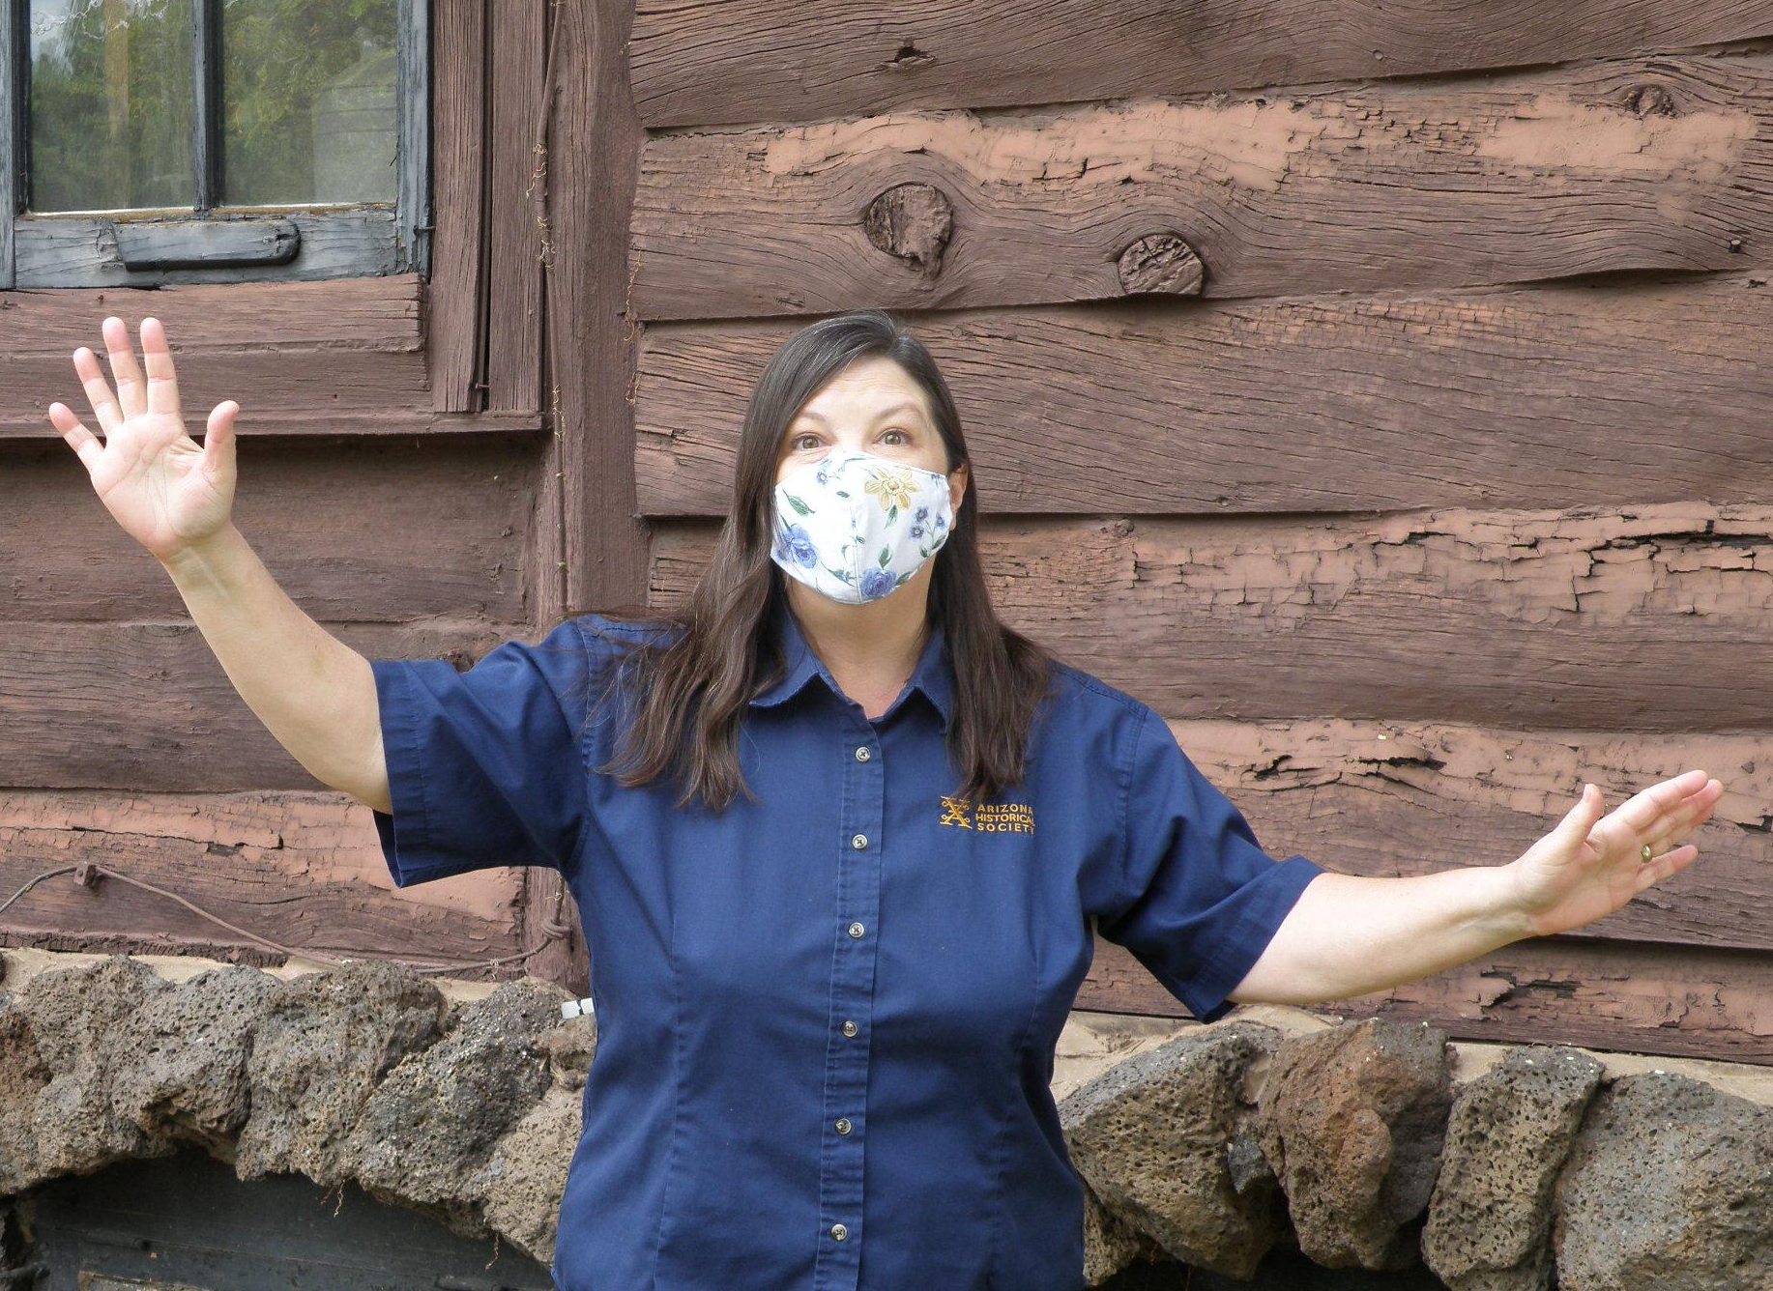
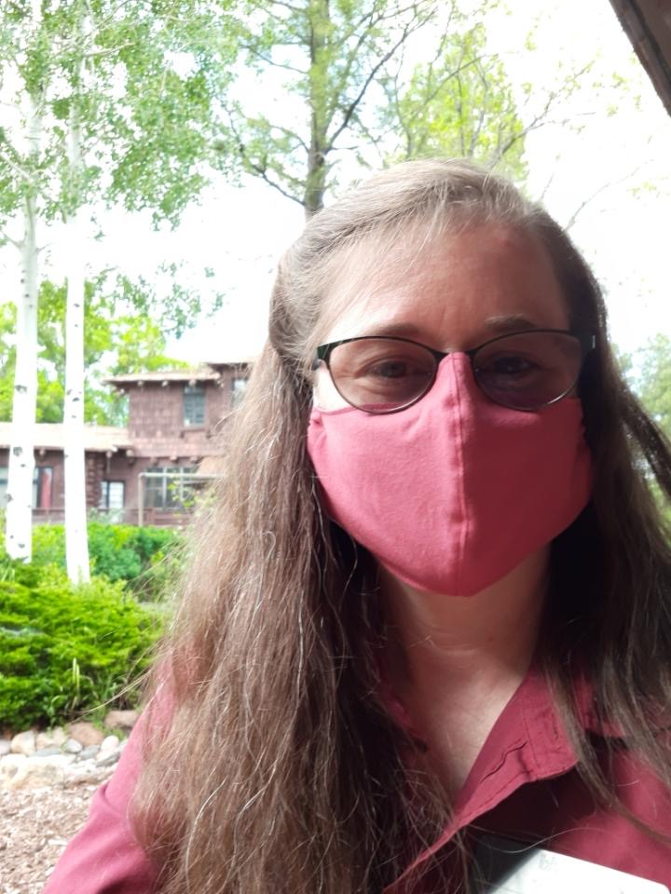
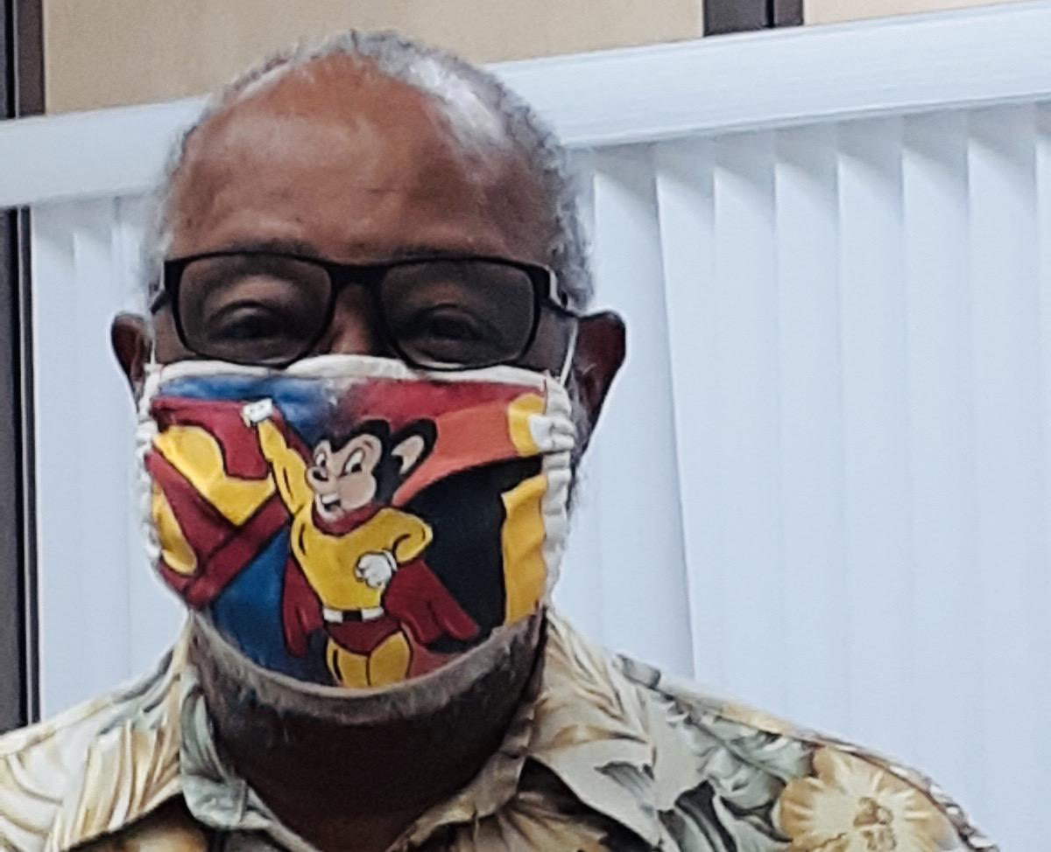
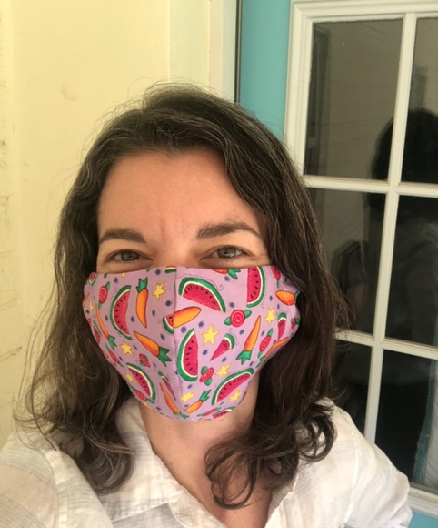
Smiles Behind the Mask
Tips for Staying Happy and Healthy at Work

Slide 2
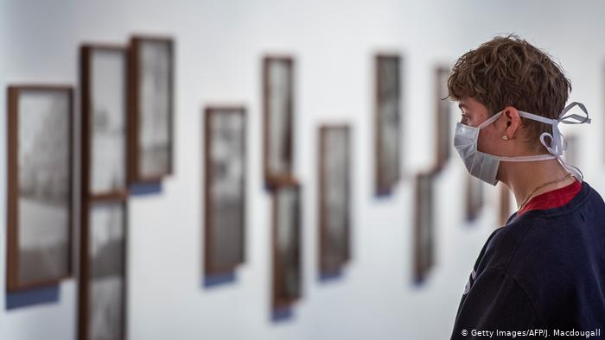
Should we wear masks while working at the museum?
Yes, please! Staff is asked to wear masks when in any public or common area of their respective museums. You may remove your mask when in your personal work station.
Notes:
Yes please! For the safety of all, we ask that staff wear masks when in any public or common area inside museums. Museum guests, vendors and visitors will be asked to wear masks, but will not be required to wear them.

Slide 3
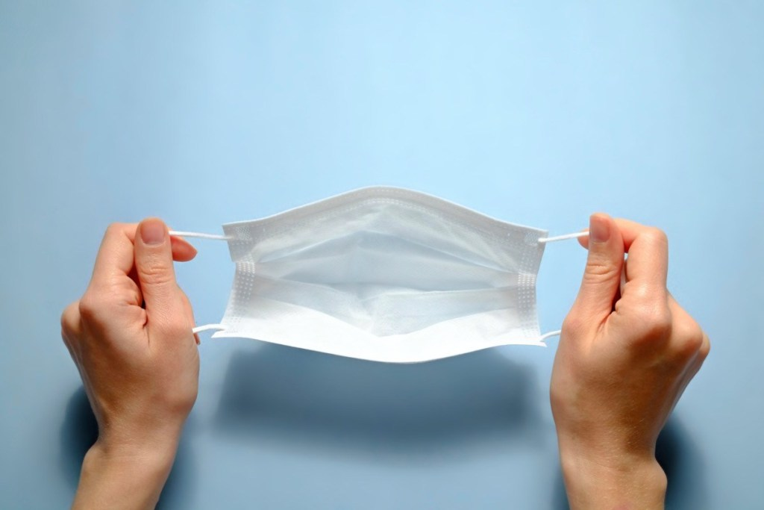
Does a mask have a front side?

Slide 4
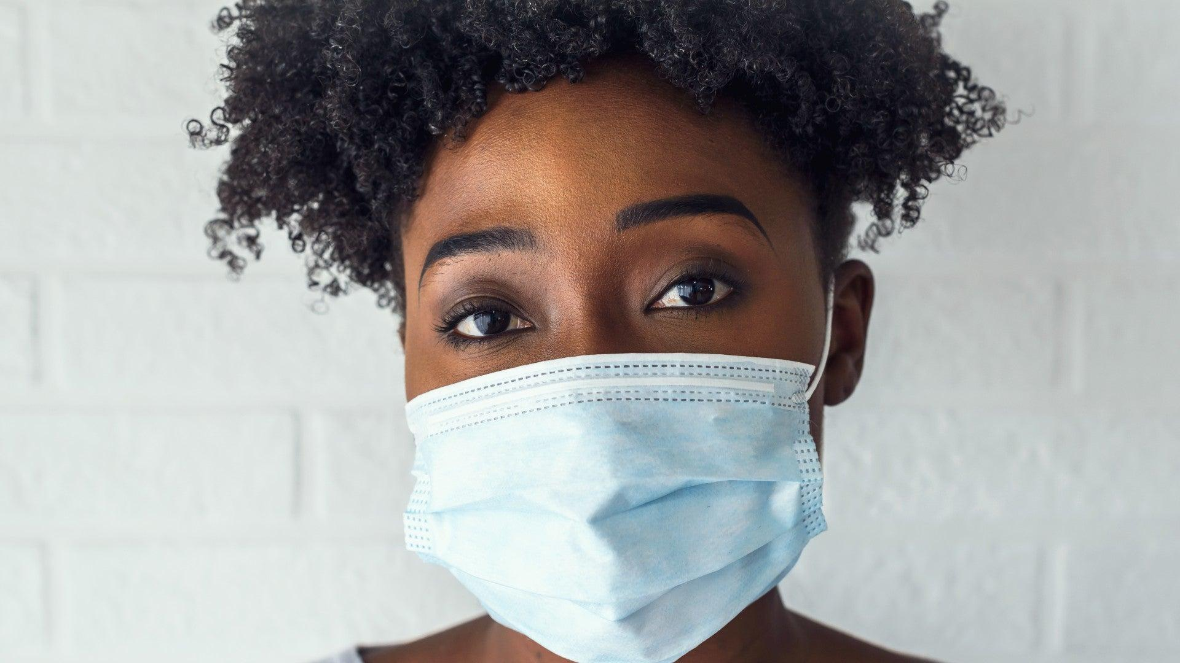
Typically...Yes!
Brands of masks differ. In this case, the blue side is waterproof - keeping droplets from others from penetrating your mask. The white side is absorbent - if you cough, your droplets are trapped inside your mask. Check your mask to see which side is waterproof and that side should face outward.
Notes:
The blue or colored side is supposed to be worn on the outside. The white side is to be worn on the inside. Why? The blue is waterproof - keeping droplets from others from penetrating into your mask. The white side is absorbent - so if you cough, your droplets are trapped in your mask. Blue side to the sky!

Slide 5
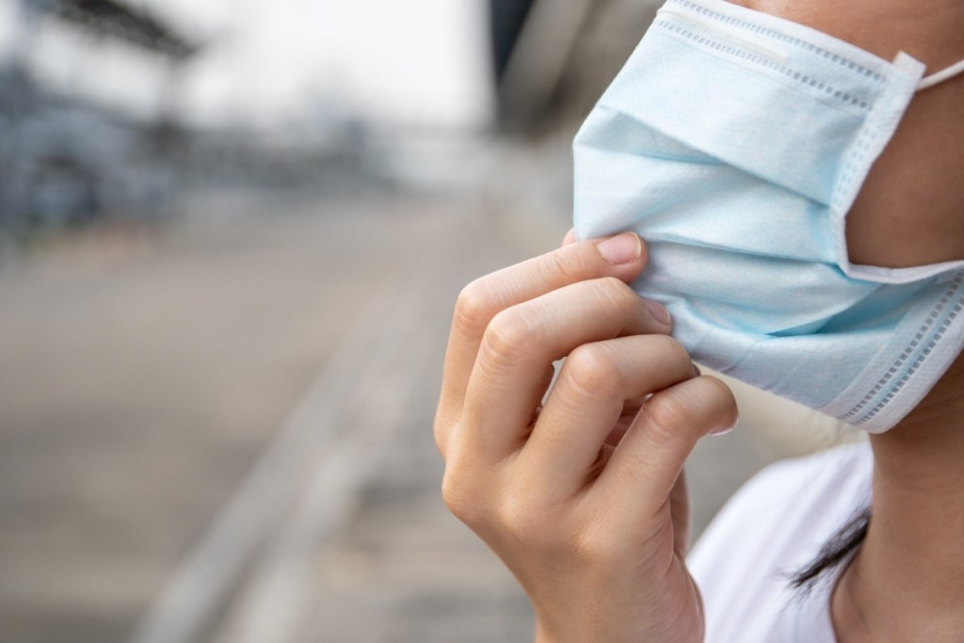
Before adjusting your mask...
Make sure your hands are clean, and be sure to wash your hands after touching the outside of the mask.
Notes:
It's best to avoid touching your face in general.

Slide 6
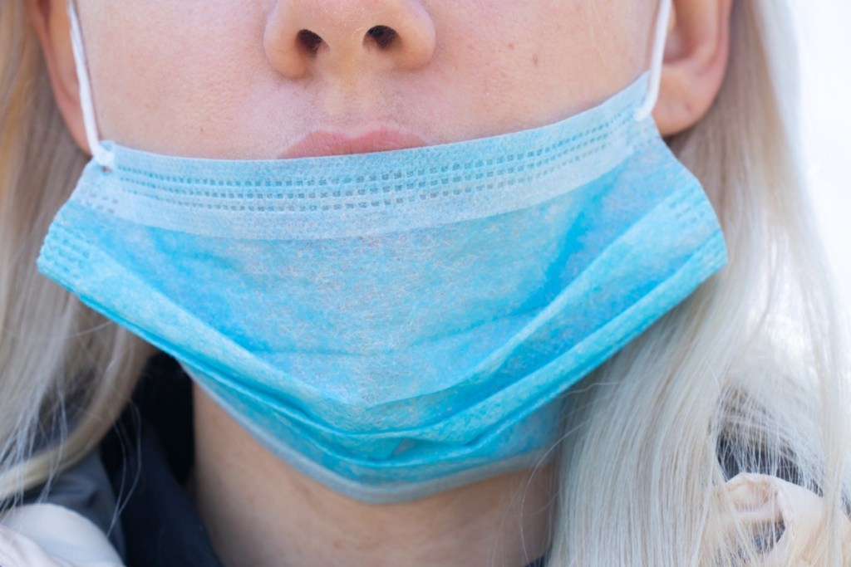
Do I need to cover my nose?
Yes! Breathe through your mask. (Not around it.)
Notes:
Many people wearing their masks below the nose. While it will still protect others if you are coughing or sneezing, it will not protect you from COVID-19 if someone else nearby is infected and coughs. Remember to cover your nose.

Slide 7
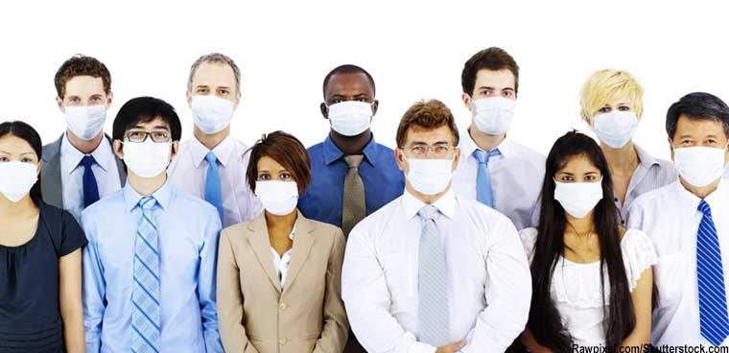
Vote! When should you put on your mask?
A. When you first arrive inside the museum
B. Before you enter the museum
Notes:
Without the mask, you're susceptible to inhaling particles in the air. Put on your mask ahead of entering an area of risk.

Slide 8
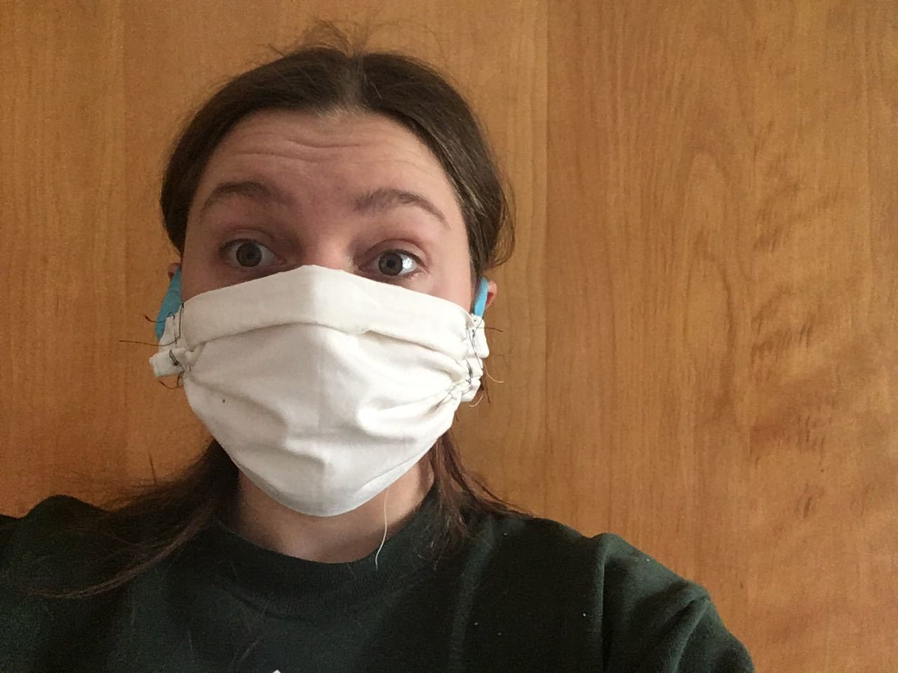
Can I wear the same mask all day at work?
A mask should be changed periodically throughout your work day.

Slide 9
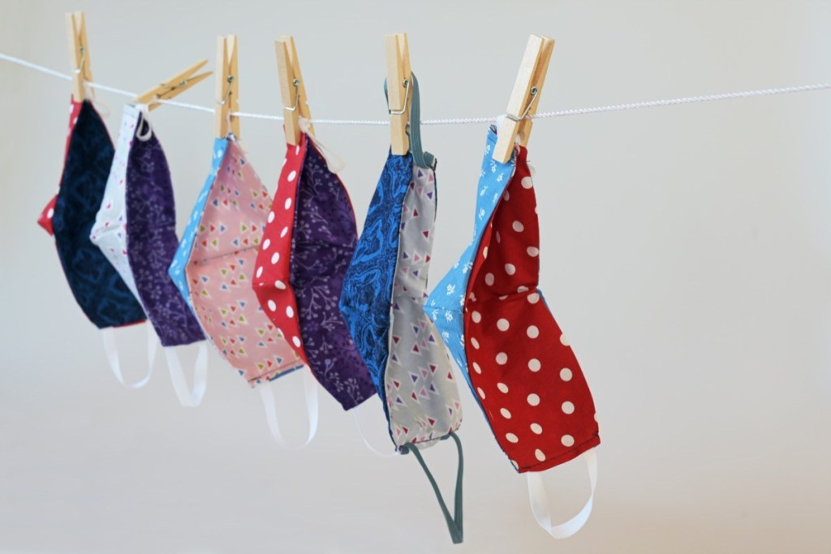
Do I need to wash my cloth mask?
Yes! Not washing it is the same as wearing a contaminated mask.
Notes:
If you use a cloth mask, not washing it is the same as wearing a contaminated mask. A washing machine with the hot water setting on, using your normal detergent should be sufficient for cleaning it. Once clean, the mask should be thoroughly dried, on a clothesline or dryer.

Slide 10
How do I prevent foggy glasses?
Use a mask with a nose bridge that can be shaped to fit your face
Pull the mask up high enough to put eye glasses over the top of your mask
Place tissue under the top edge of your mask to absorb moisture
Notes:
When your warm breath escapes through the top of the mask, it hits the lenses of your glasses and causes them to fog up. To avoid this problem, buy masks with a nose bridge or masks that can be shaped to fit the face. Also, pull the mask up high enough to put your glasses over the top edge of the mask. Notice the blue side of his mask is facing outward.

Slide 11
Remember...
Please do not wear masks with political messaging.

Slide 12
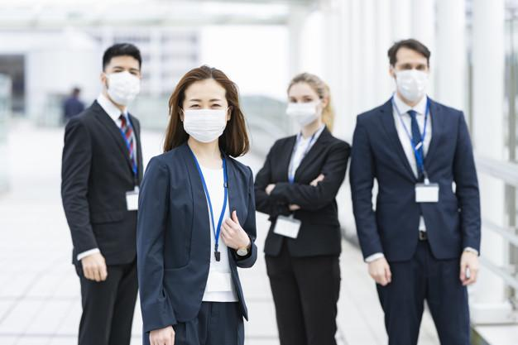
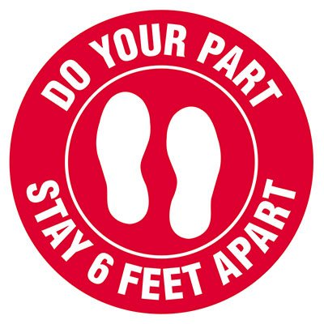
Is social distancing still necessary when wearing a mask?
Yes! Masks decrease risk, but social distancing is ultimately the most important step you can take to keep safe.
Notes:
Many people think the mask is 100 percent reliable, but it is meant to decrease the risk. Ultimately, social distancing is the most important step you can take to to keep safe. At AHS, we ask that people always respect the minimum 6ft social distancing guideline.

Slide 13
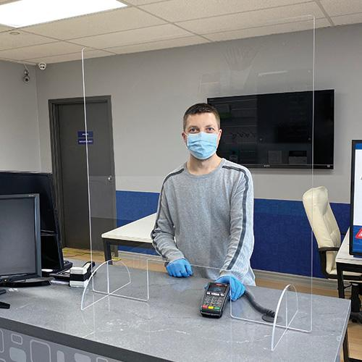
Do I need to wear a mask when behind a sneeze barrier?
It is best to keep masks on even when behind a shield.
Notes:
The public is expecting staff to be wearing masks.

Slide 14
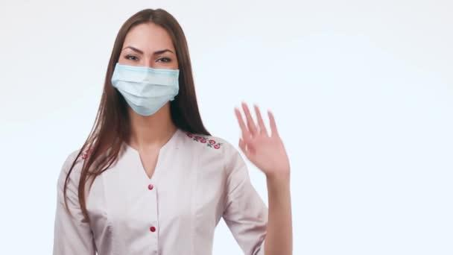
How should visitors be greeted?
When greeting visitors, add a friendly wave to your “Hello!”
Notes:
Visitors cannot see your smiling face behind the mask. When greeting visitors, add a friendly wave to your “hello!” They cannot see your happy smile.

Slide 15
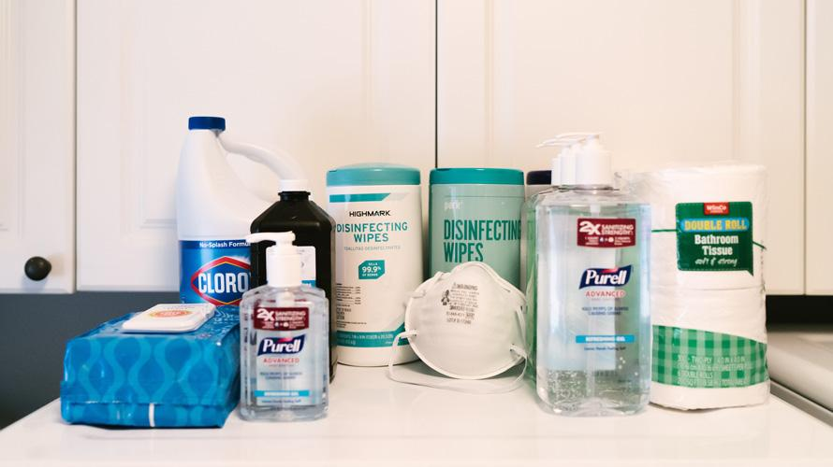
Keep your workstation germ-free!
Be the guardian of your personal workstation. Wash your hands frequently.
Sanitize your...
Phone
Light Switch
Door Knob
Keyboard
Mouse...

Slide 16
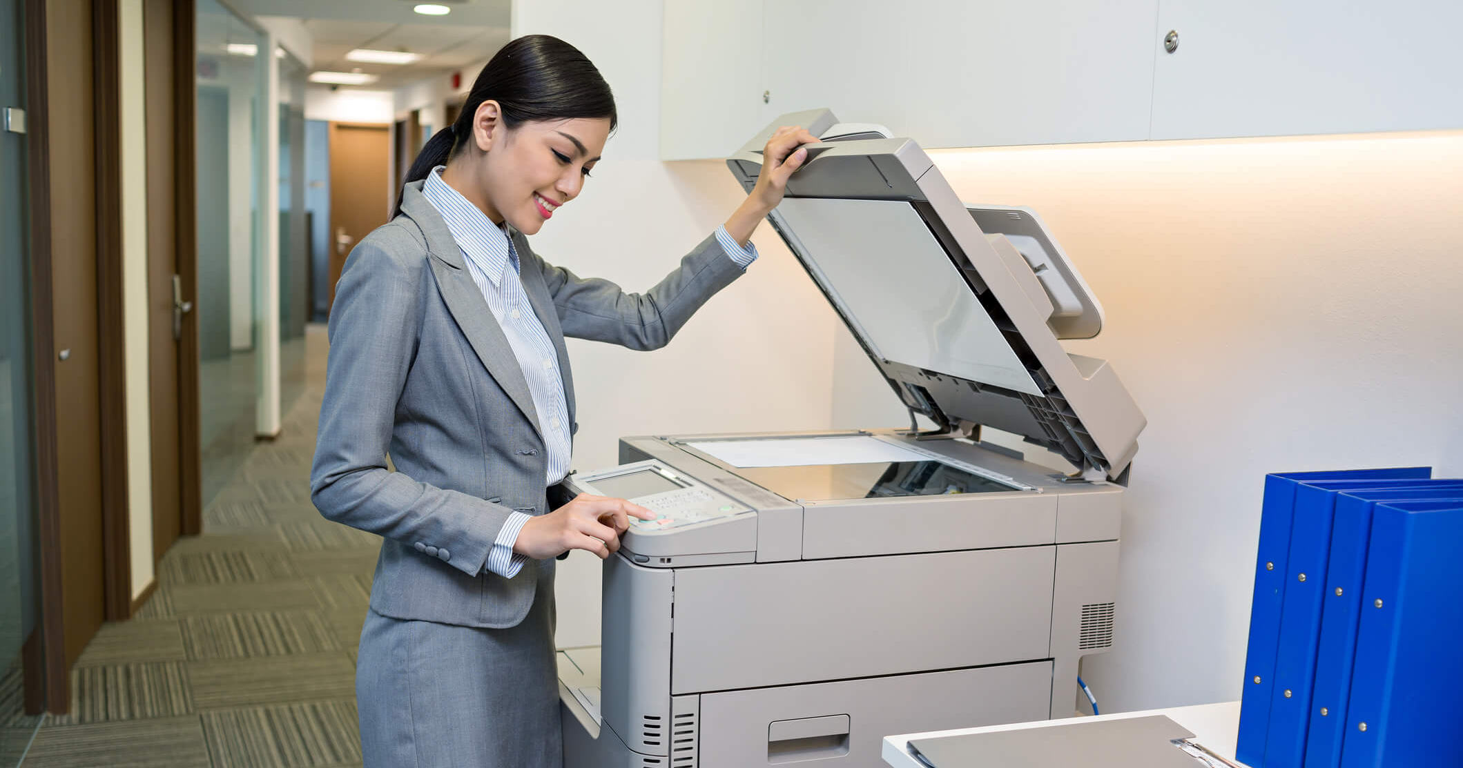
Help keep common work areas clean
Clean copiers before and after use, wiping with a cloth sprayed with disinfectant.
Arizona History Museum:
Administrative team will support sanitizing of staplers and tape dispenser.
Arizona Heritage Center:
These items have been removed for your safety.

Slide 17
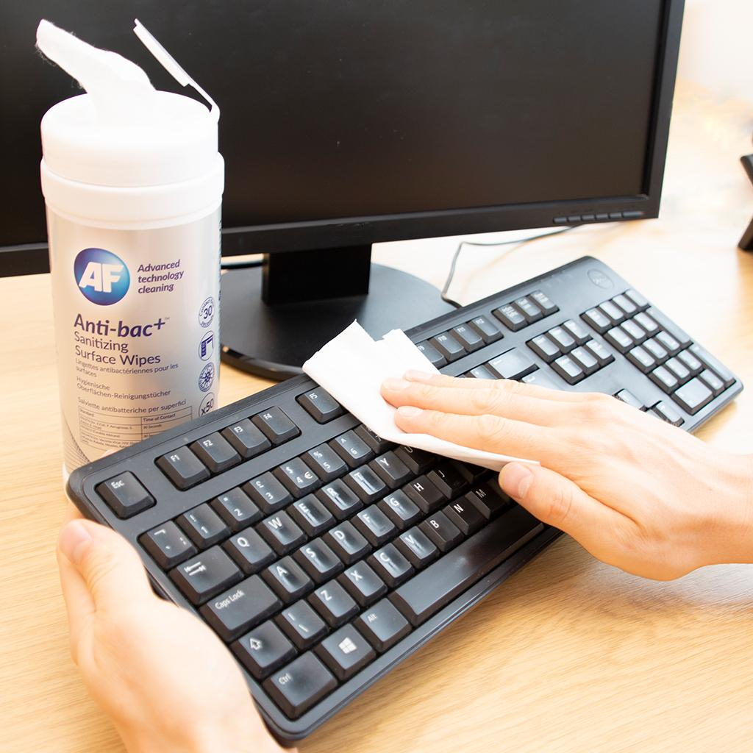
Should I spray disinfectant on my keyboard?
No. Spray disinfectant on a clean, single-use paper towel and wipe the keyboard. Spraying disinfectant directly on keyboards and other electronic equipment can damage them.

Slide 18
How should I wash my hands?
Follow these five steps every time:
Wet your hands with clean, running water (warm or cold), turn off the tap, and apply soap.
Lather your hands by rubbing them together with the soap. Lather the backs of your hands, between your fingers, and under your nails.
Scrub your hands for at least 20 seconds.
Rinse your hands well under clean, running water.
Dry your hands using a clean towel or air dry them.

Slide 19
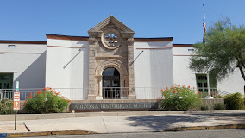
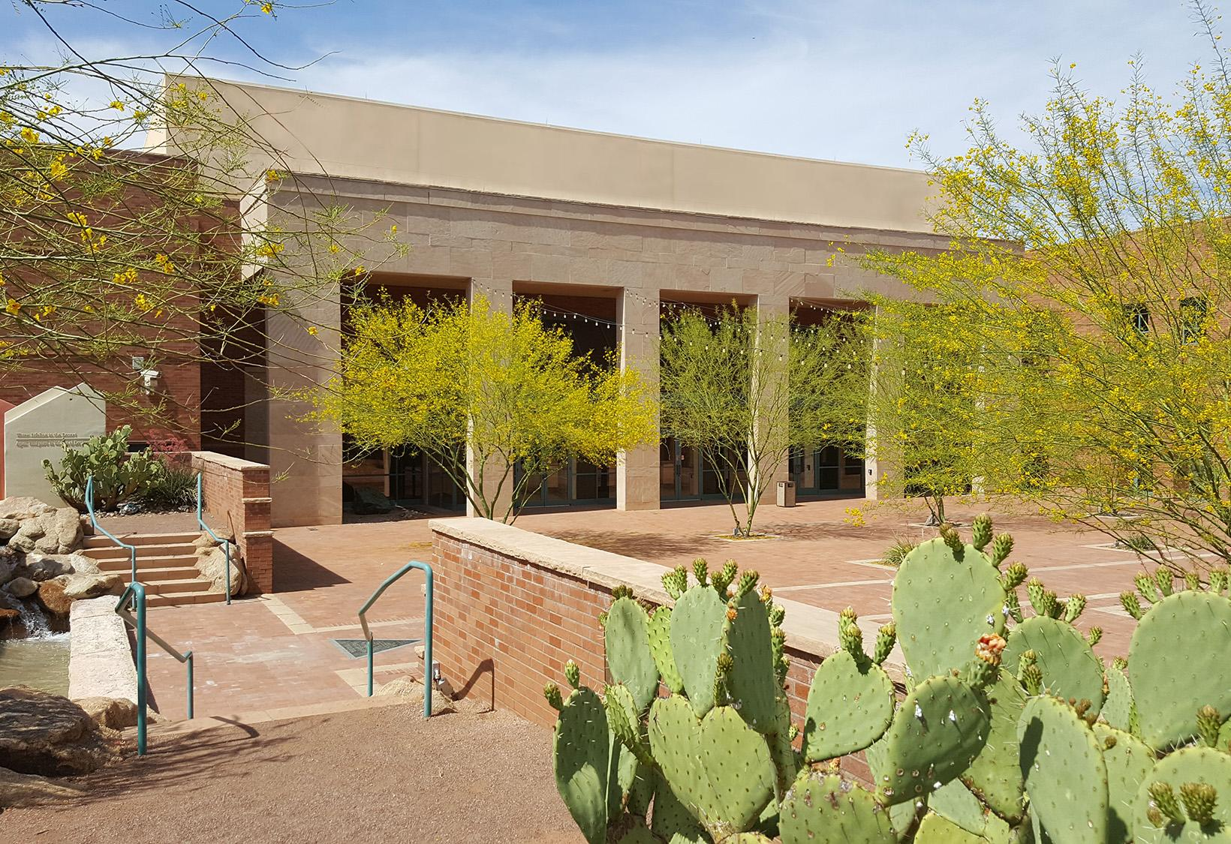
Let’s talk about our visitors...

Slide 20
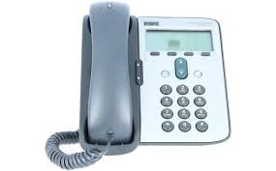
Prepare visitors before they arrive.
Prepare visitors before they arrive for what to expect when they arrive at the museum.
Website
Email Communications
Social Media
Outdoor Signage
Telephone Messaging

Slide 21
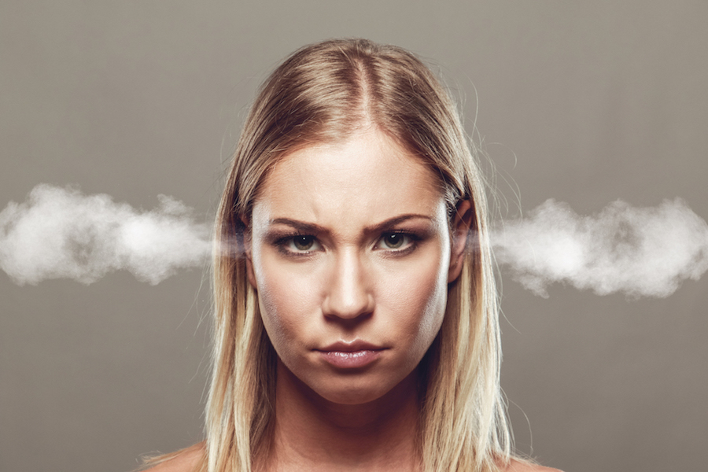
What if a visitor gets upset?
Why are you wearing a mask?
Why aren’t others wearing masks?
Why do I have to wait to enter?
Why are your hours reduced?
Notes:
We are wearing masks for your protection; we cannot mandate what others do; there are others in the museum, and we want to ensure we can maintain social distancing to protect you; to allow us to sanitize the museum for your safety.

Slide 22
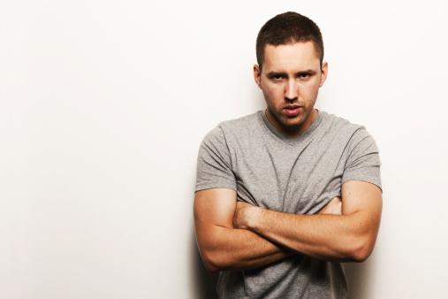
Tips to de-escalate tension...
Listen
Give your undivided attention
Remain calm
Show empathy Empathy needs to be shown during conflict situations. Even if you do not agree with the person’s position, expressing understanding will help resolve the conflict.

Slide 23
Times are tough. Be patient.
5. Be aware of your tone and body language
6. Apologize when appropriate Accepting responsibility and sincerely
apologizing for anything in the situation that is believed to be upsetting can make a significant difference.
Notes:
The same words spoken with a different tone will be received in a completely different way.

Slide 24
Times are tough. Be patient.
7. Recognize your personal boundaries. Ask for help!
Arizona History Museum: Mel Davis, Bill Ponder, Kim Bittrich, David Turpie
Arizona Heritage Center: Tawn Downs, Debbie McKinion, Marilyn Murphy, Shelley Coriell
Pioneer Museum: Jill Hough
Riordan Mansion: Nikki Lober
Sanguinetti House Museum: Yanna Kruse
Notes:
People have different thresholds of tolerance for behavior. If you start feeling uncomfortable with a situation...call for help.

Slide 25
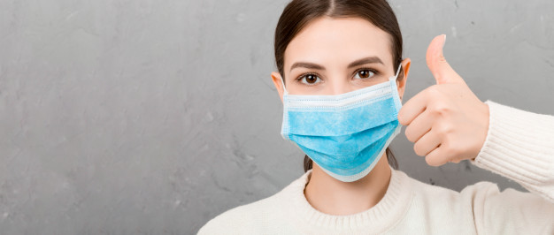
Most important...
8. Keep yourself and others safe.

Slide 26
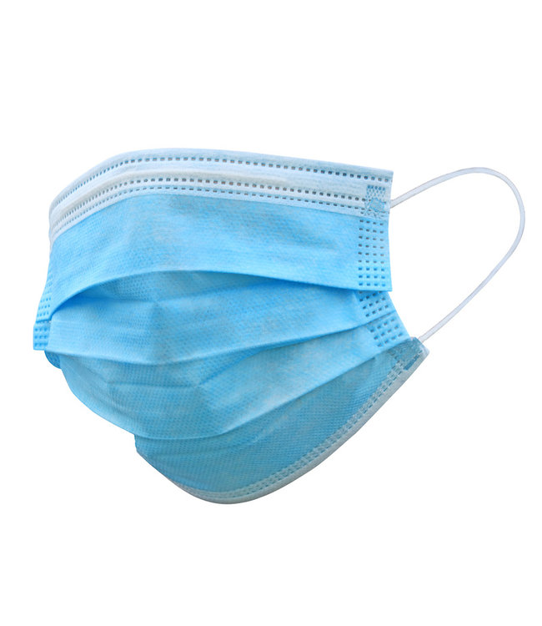
Questions and Responses...
Q. Why are you wearing a mask?
“My mask is for your protection. I don’t know if I have been exposed and want to make sure you don’t get sick.

Slide 27
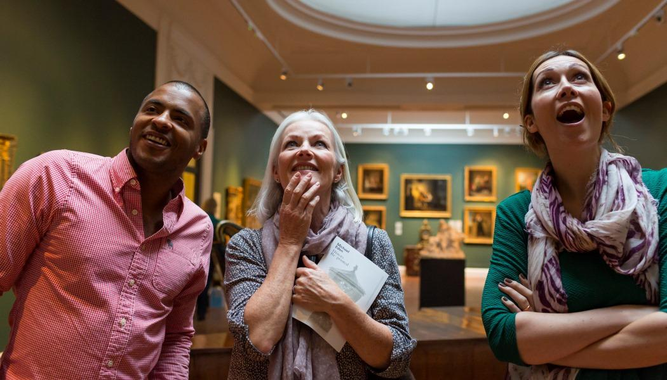
Questions and Responses...
Q. Why aren’t you making visitors wear masks?
“We are unable to mandate that others wear masks.”

Slide 28
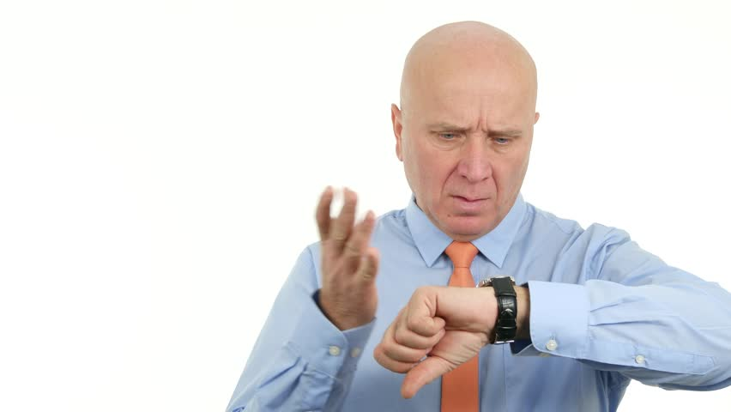
Questions and Responses...
Q. Why do I have to wait to enter the museum?
“We want to keep you safe and there are several other people inside the museum.”

Slide 29
Questions and Responses...
Q. Why have you reduced museum hours?
“Hours have been reduced to ensure we have time to sanitize the facility and keep you safe.

Slide 30
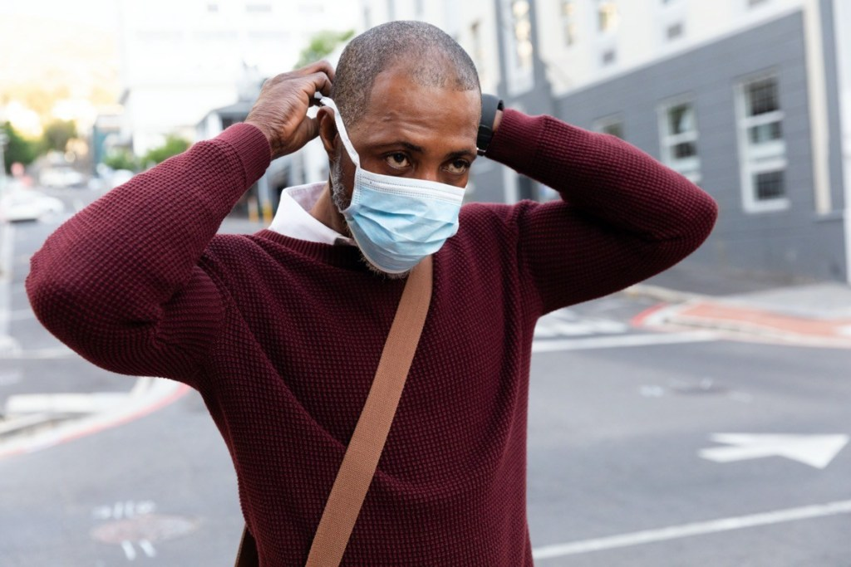
At the end of the day… How should you remove the mask?
Wash your hands. Unloop the mask from your ears and avoid touching the outside of the mask. Wash your hands.
Notes:
When you're done wearing the mask for the day, there's a chance you could contaminate yourself taking it off. Wash your hands before taking off the mask. Take it off by unlooping it from your ears first.

Slide 31
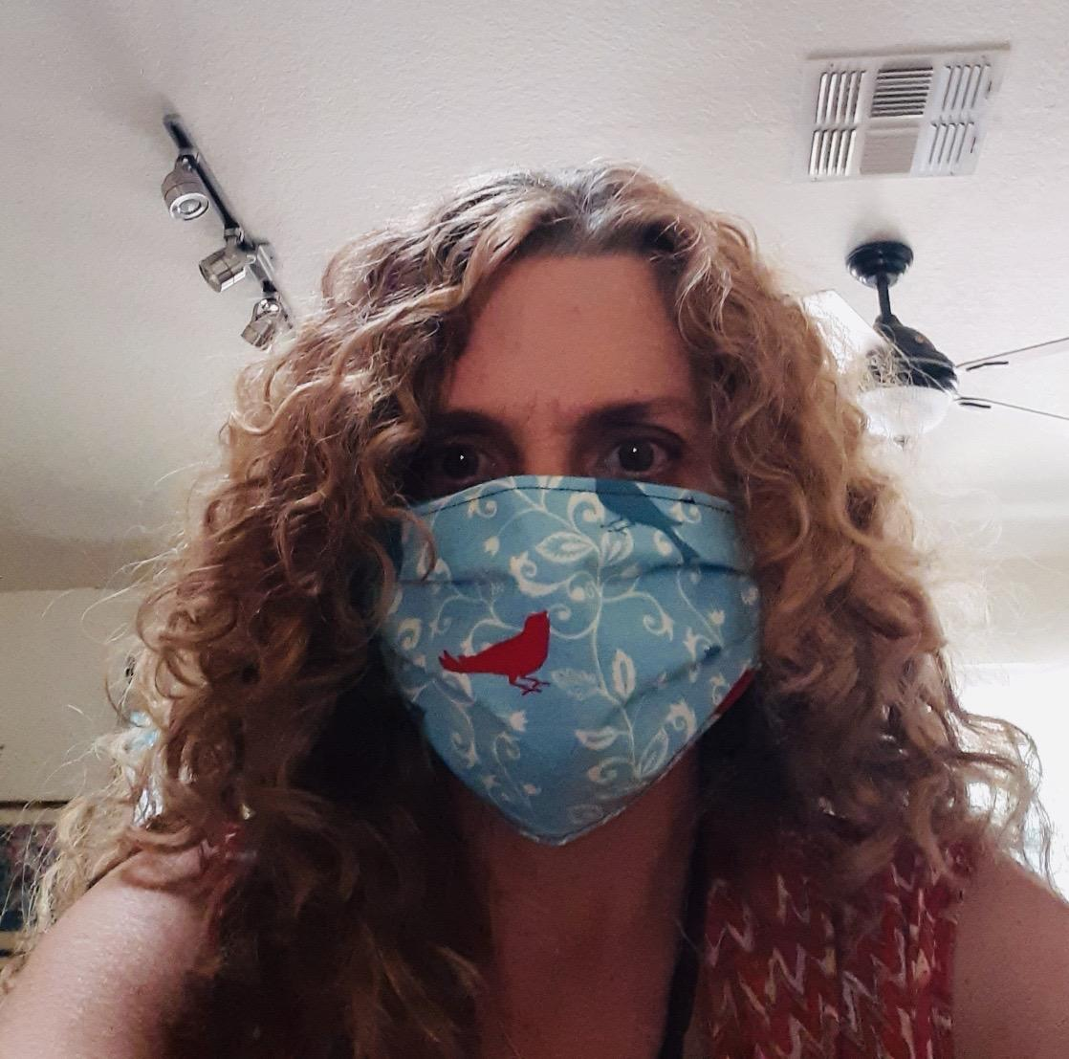
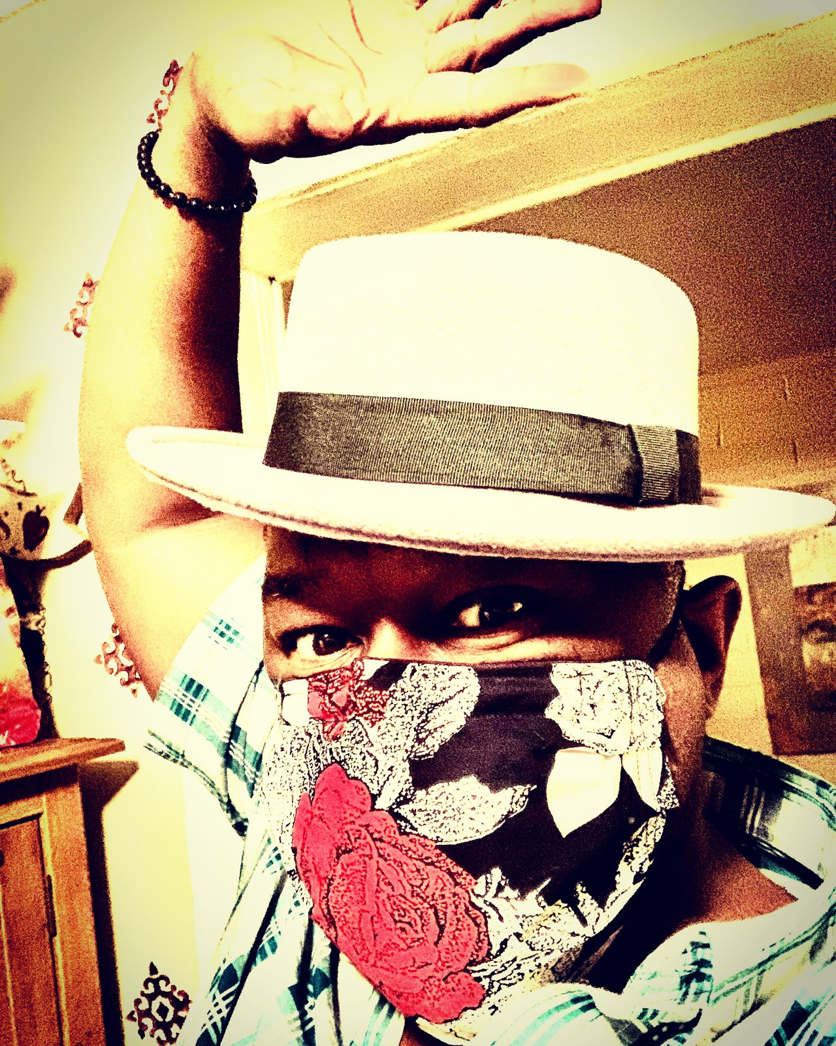
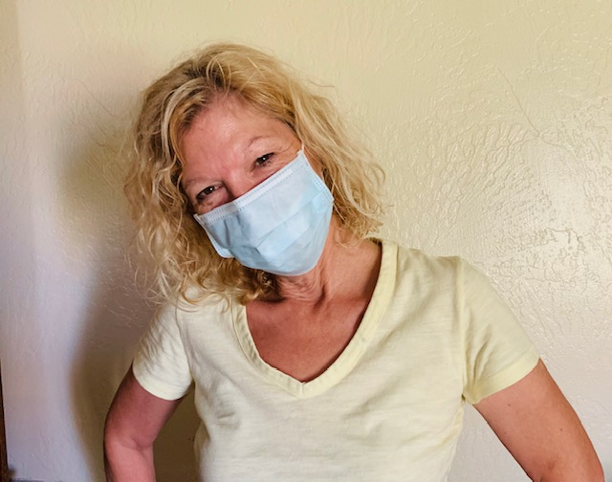
Questions or Comments?
We will get through this together!

Slide 32
Thank You

